Slide 1
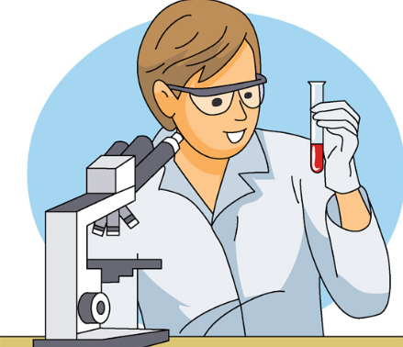
Chapter 01 Science Inquiry
Intro to Scientific Method
Types of Investigation

Slide 2
What is science?
Two aspects:
A process of inquiry
a way of finding out about things.
Scientists observe the world and come up with ideas:
About connections between things
About why things happen
Scientists use a systematic process “the scientific method” to explore connections and prove/disprove them.
A body of knowledge
Gained by systematic observation and testing of ideas.

Slide 3
In human biology and medical research…
Inquiry, for example:
Formulating and testing drugs
Studying human health over time
Gathering data on human systems
Leads to medical advances and more accurate understandings – contributes to a body of knowledge

Slide 4
Types of Investigation

Slide 5
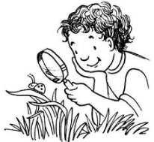
Observations
Using senses and measuring equipment
Gathering, collating and analysing data gathered
Looking for patterns and relationships within the data.
Examples:
Observation of animal behaviour
Discovery of Helicobacter pylori

Slide 6

Surveys
Collection of data from a large number of people.
Questionnaire or interview.
Can reveal patterns of behaviour, provide ideas about connections (eg lifestyle and heart disease).
Often used in conjunction with other data collection methods.

Slide 7

Trial and Error
Systematic
Testing things in turn
Can be prolonged/time consuming
Keeping very accurate records
Example: testing different chemical compounds from plants, to see whether they have an antibiotic effect on bacterial colonies

Slide 8
Case Studies
In depth investigation and report of a specific situation.
Can be used to track the progress of a disease in an individual, to learn more about disease in general, or to confirm other data.
Have limitations – can be too narrow in view, lack validity.

Slide 9
Longitudinal Studies
Conducted over a long period
Gathers data repeatedly
Picture of change over time
Can establish links between lifestyle and health
Eg: Longitudinal studies of women’s health.
Longitudinal monitoring of smoking habits and disease.

Slide 10
Controlled Experiments
Designed to investigate relationships between factors.
Variables carefully controlled.
Validity carefully monitored.
Tests a hypothesis
Data undergoes statistical analysis to determine probability that hypothesis is correct.
Eg: testing whether a particular drug is effective.

